Slide 1
Architecture deployment approaches - II
Pravin Y Pawar

Slide 2
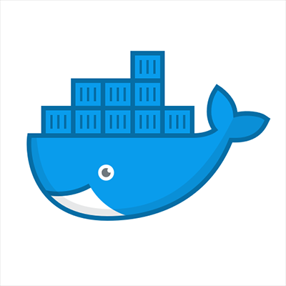
Containers
Containers are an interesting solution that enables PaaS-like benefits without the IaaS overhead
A container is essentially a runtime that contains the bare essentials needed to run a unique application
The kernel or core part of the host operating system and services such as storage are shared across a host
The shared kernel enables containers to be lightweight
some are mere megabytes in size, compared to the gigabyte size of typical virtual machines
With hosts already running, containers can be started quickly, facilitating high availability
The ability to spin up containers quickly also provides extra layers of resiliency
Docker is one of the more popular implementations of containers.
Benefits of containers include:
Lightweight and portable
Self-contained so no need to install dependencies
Provide a consistent environment regardless of the host (runs exactly same on a laptop as on a cloud server)
Can be provisioned quickly for scale-out
Can be restarted quickly to recover from failure
Source: Twitter

Slide 3
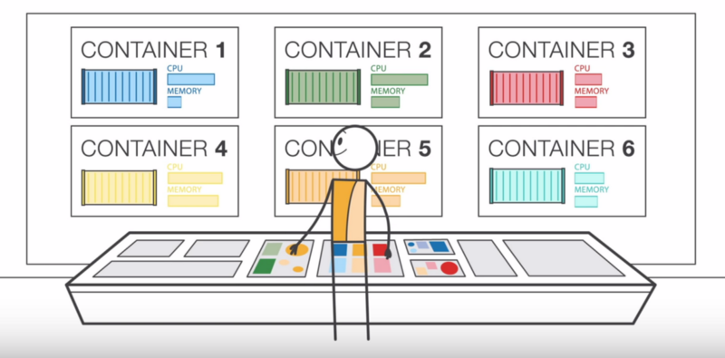
Container as a Service
A container runs on a container host (that in turn may run on a bare metal machine or a virtual machine)
Multiple containers or instances of the same containers may run on a single host
For true failover and resiliency, containers must be scaled across hosts
Managing containers across hosts typically requires an orchestration tool such as Kubernetes
Many cloud providers provide orchestration services through PaaS solutions to simplify the management of containers
Containers as a service (CaaS) is a cloud service model that allows users to upload, organize, start, stop, scale and otherwise manage containers, applications and clusters
enables these processes by using either a container-based virtualization, an application programming interface (API) or a web portal interface
source:freecoecamp

Slide 4
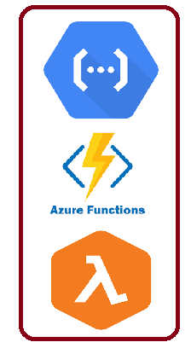
Functions as a Service (FaaS)
A category of cloud computing services that provides a platform allowing customers to develop, run, and manage application functionalities
without the complexity of building and maintaining the infrastructure typically associated with developing and launching an app
Building an application following this model is one way of achieving a "serverless" architecture
typically used when building microservices applications
Functions as a Service (FaaS) is a specialized container service that is similar to serverless
A specific implementation of FaaS, called OpenFaaS, sits on top of containers to provide serverless capabilities
OpenFaaS provides templates that package all of the container dependencies necessary to run a piece of code
Using templates simplifies the process of deploying code as a functional unit
Although it provides serverless functionality, it specifically requires you to use Docker and an orchestrator

Slide 5
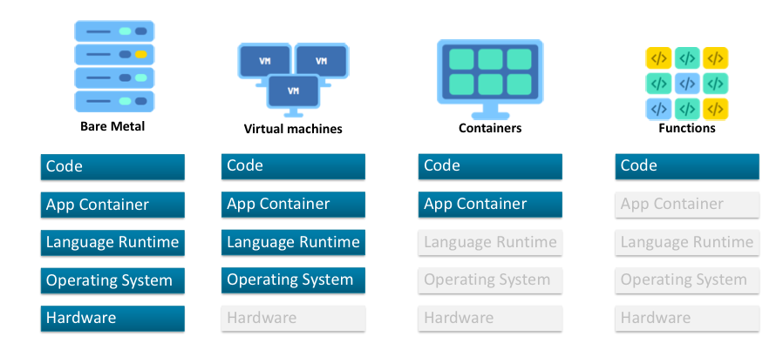
Evaluation of Cloud Services
source : Oracle blog

Slide 6
Thank You!
Reference:
Serverless apps Architecture patterns and Azure implementation
By Microsoft
In our next session:

